Slide 1



Slide 3
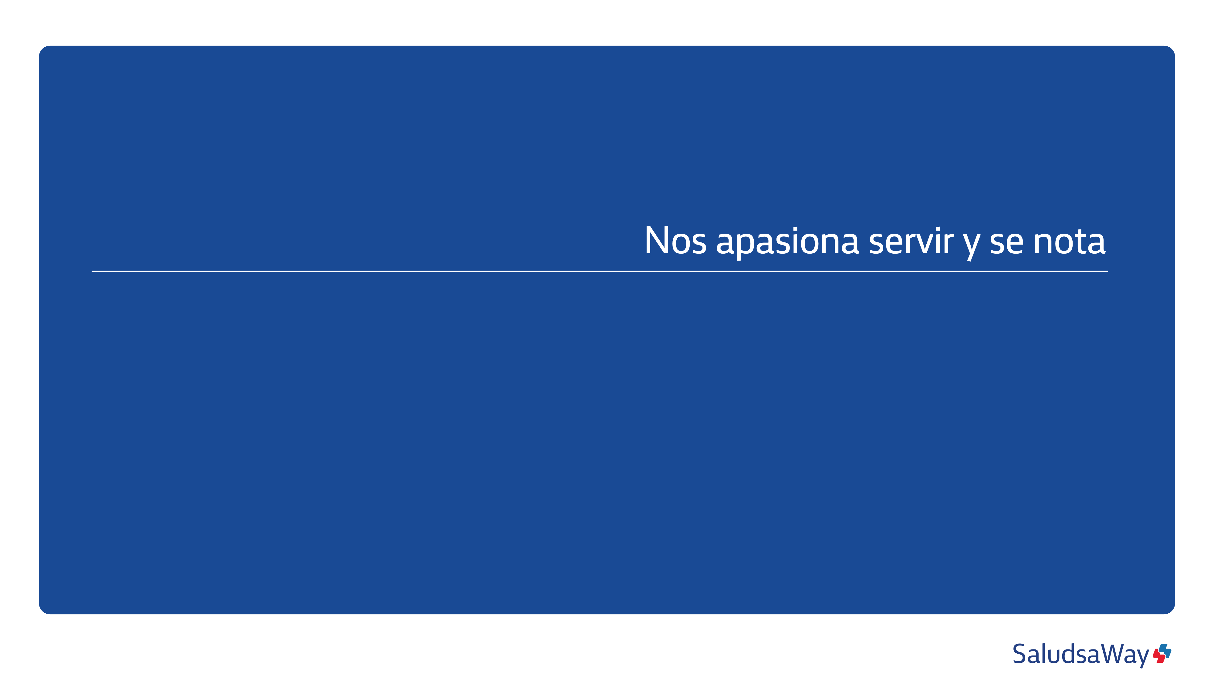


Slide 4
1

Slide 5

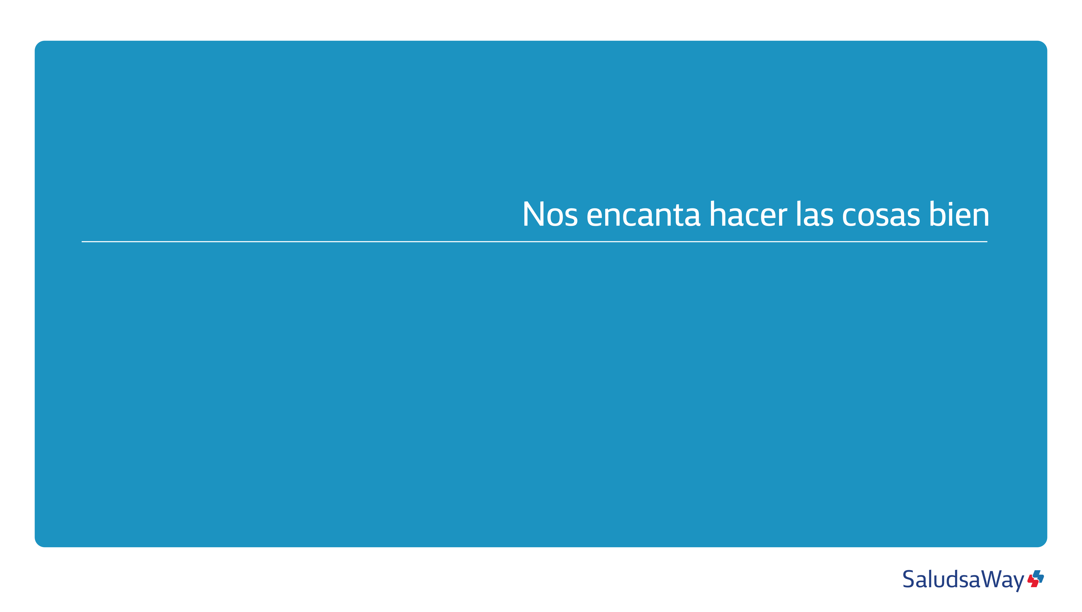

Slide 7



Slide 9



Slide 11
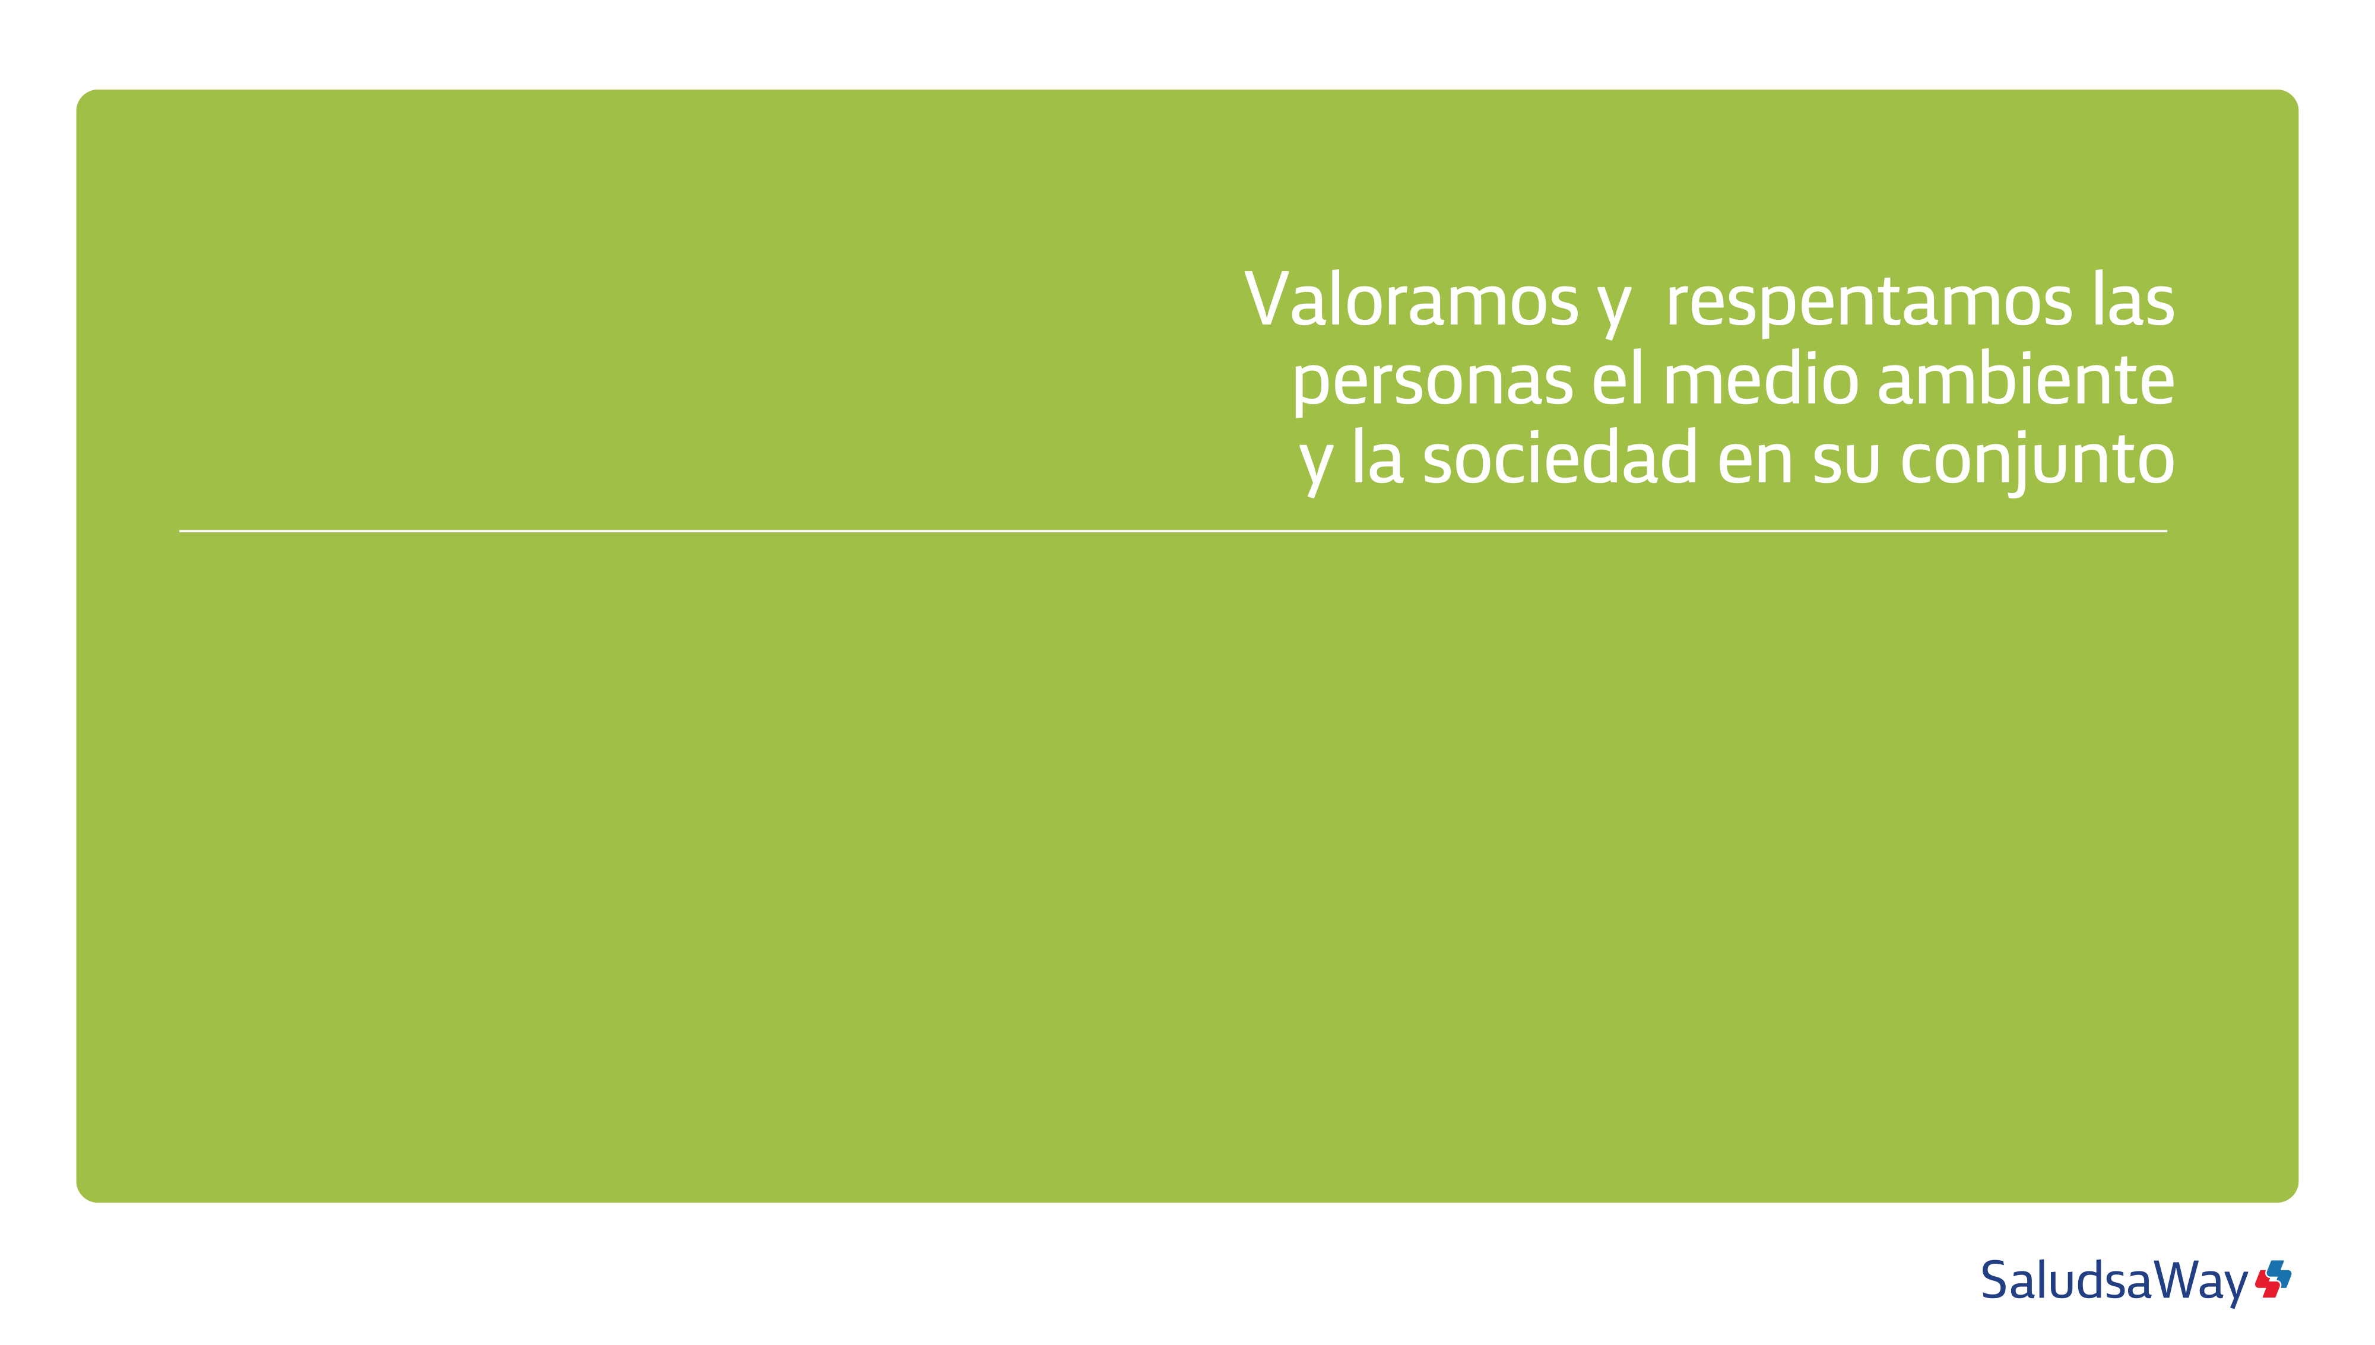


Slide 13


Slide 14


